Slide 1
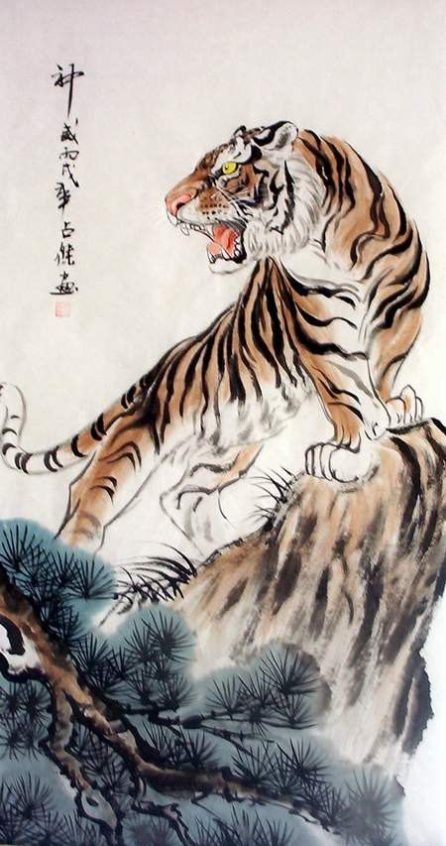
The Jungle Game
Chesshire Coders
Angélica Fallas
Taner King
Adam Gundem
Alexander Hennings
Cameron Ackerman
Image from: http://www.tattoodaze.com/tattoo-images/79/th_tiger-art-decor-mountain-tiger-tiger-hand-painting-original-bkLbwV.jpg

Slide 2
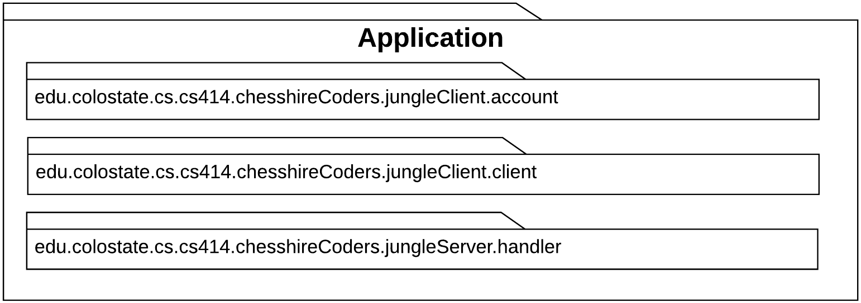
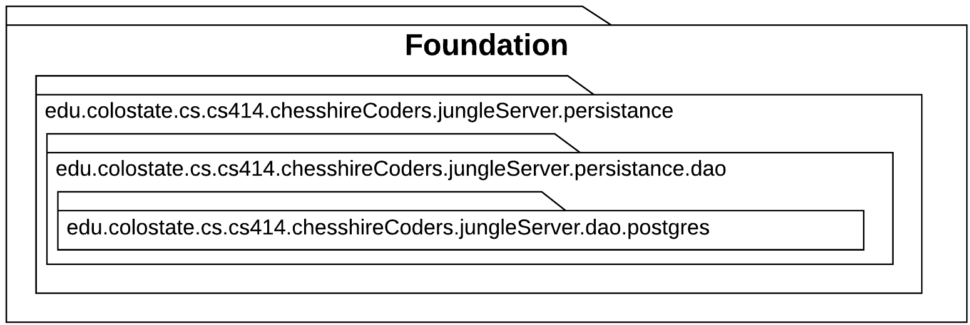
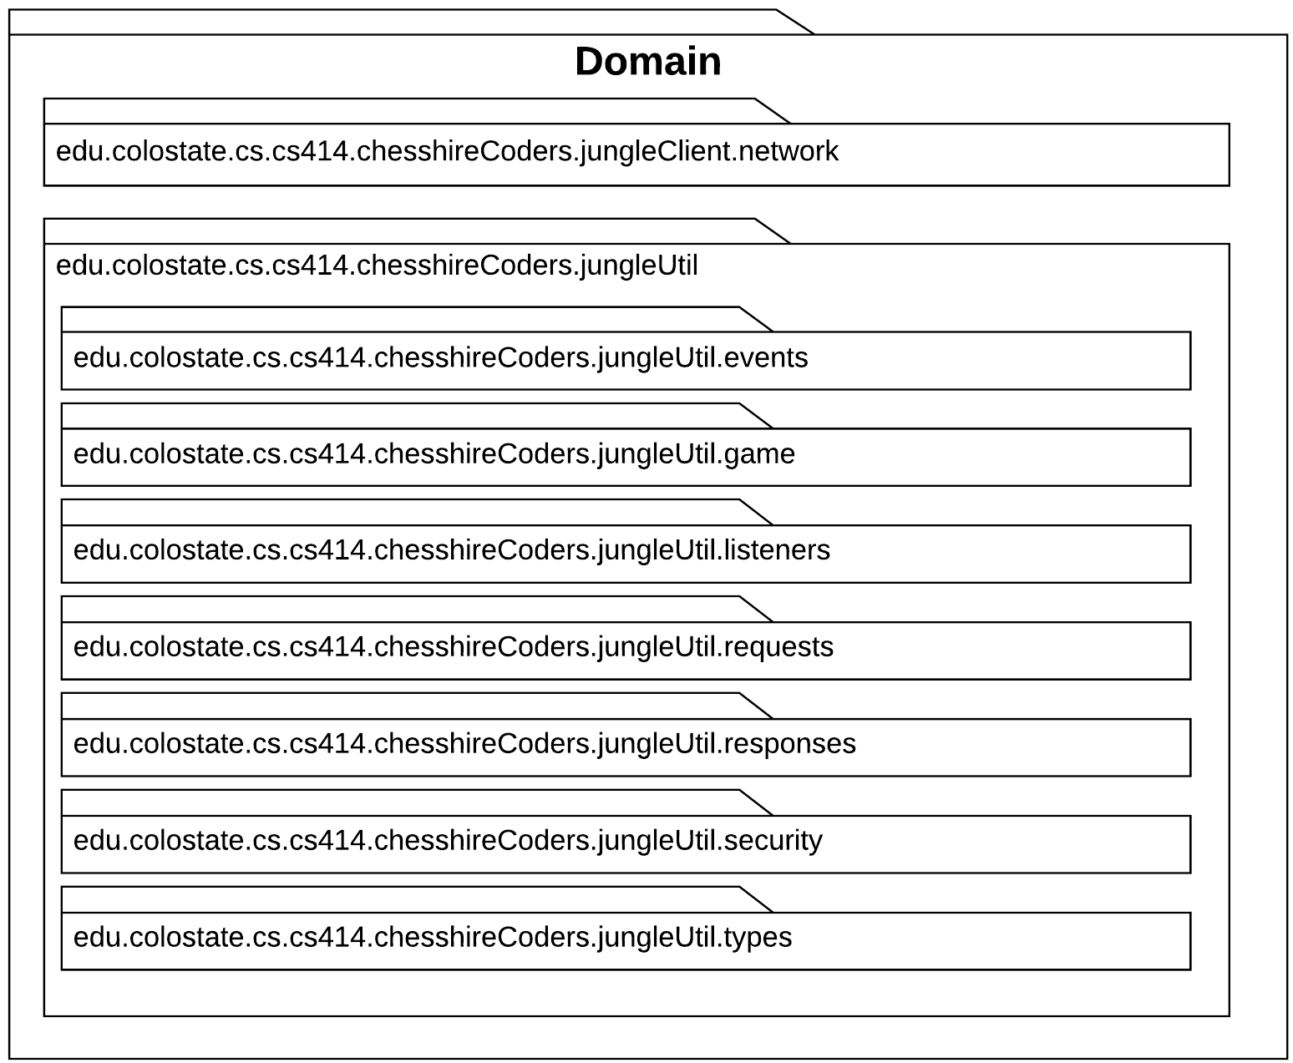
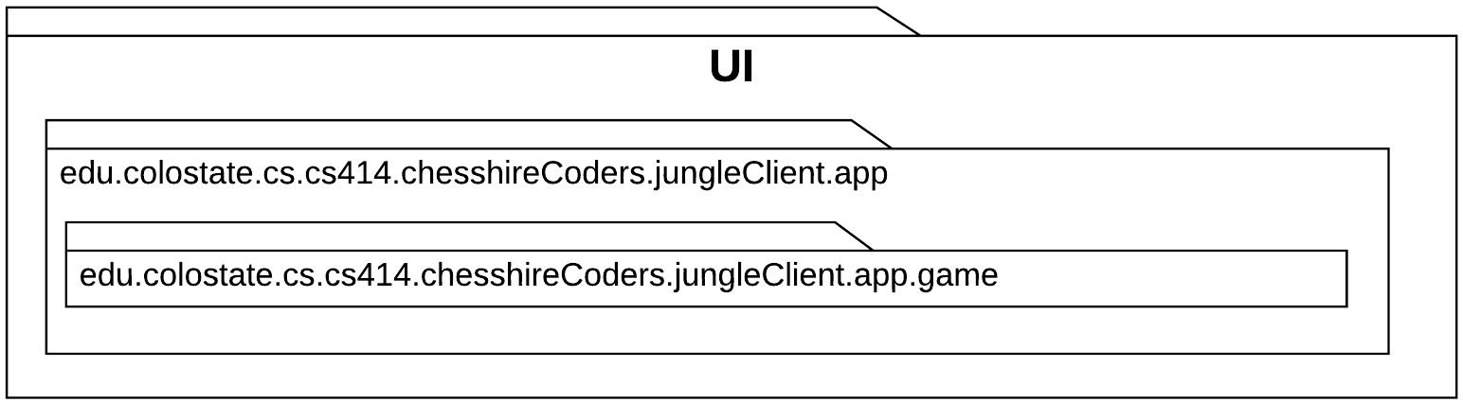
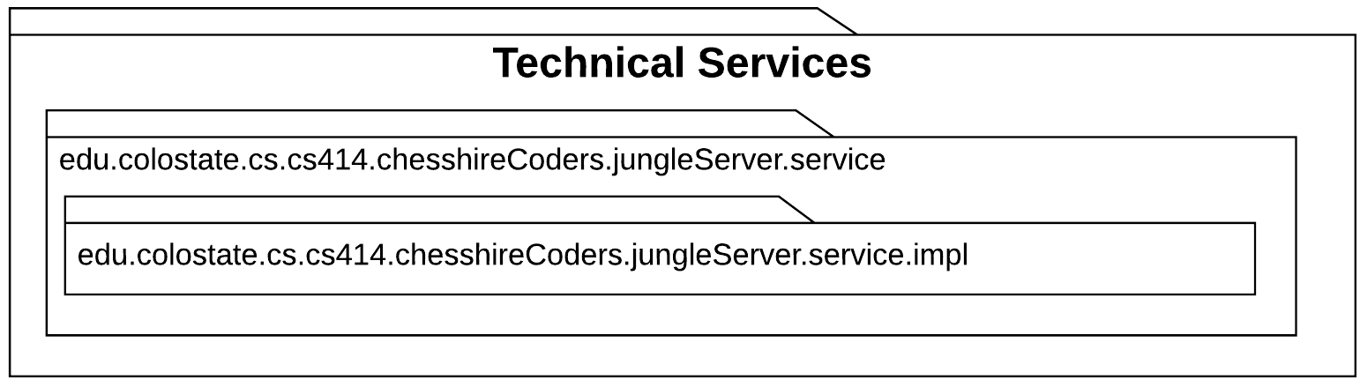
Logical Architecture

Slide 3
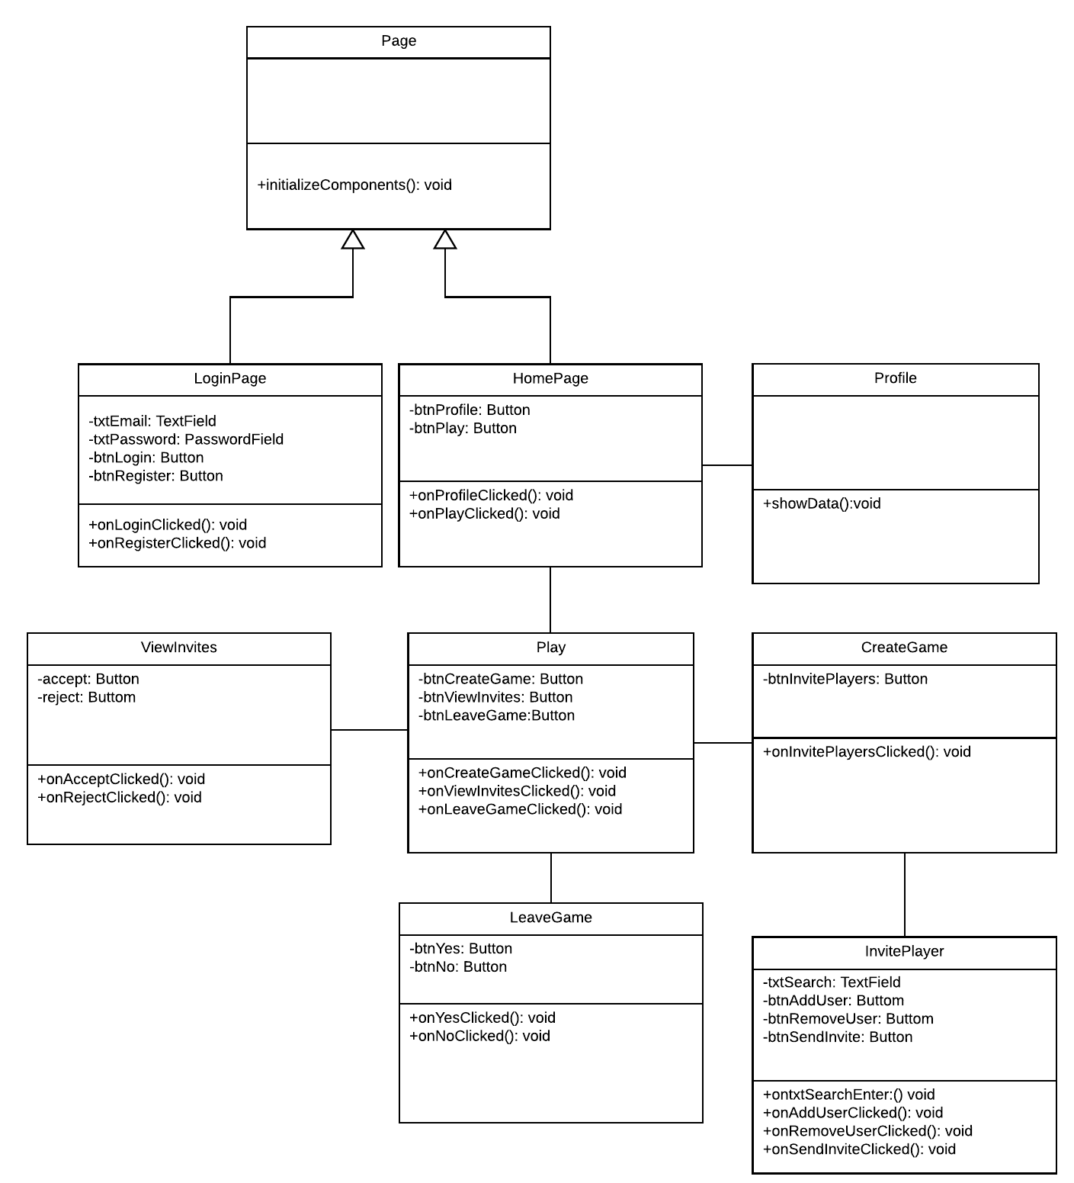
Design Class Diagram: Front End

Slide 4
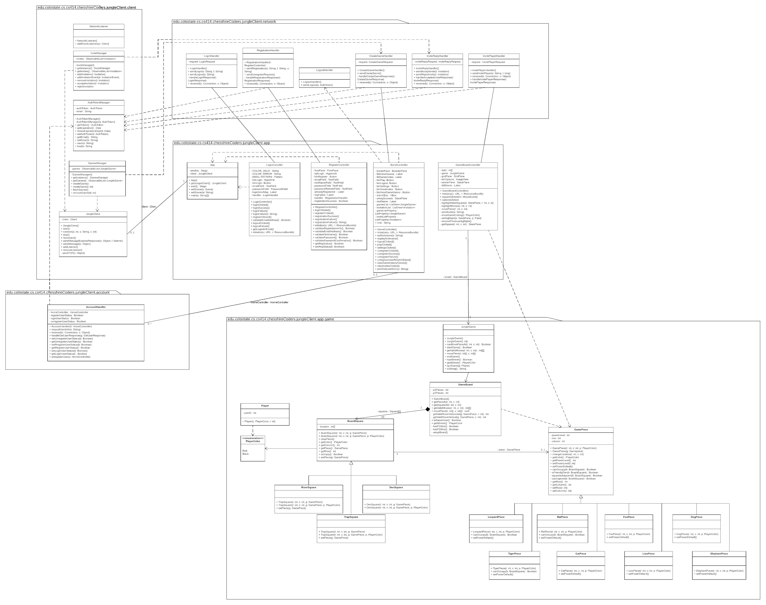
Design Class Diagram: Jungle Client

Slide 5
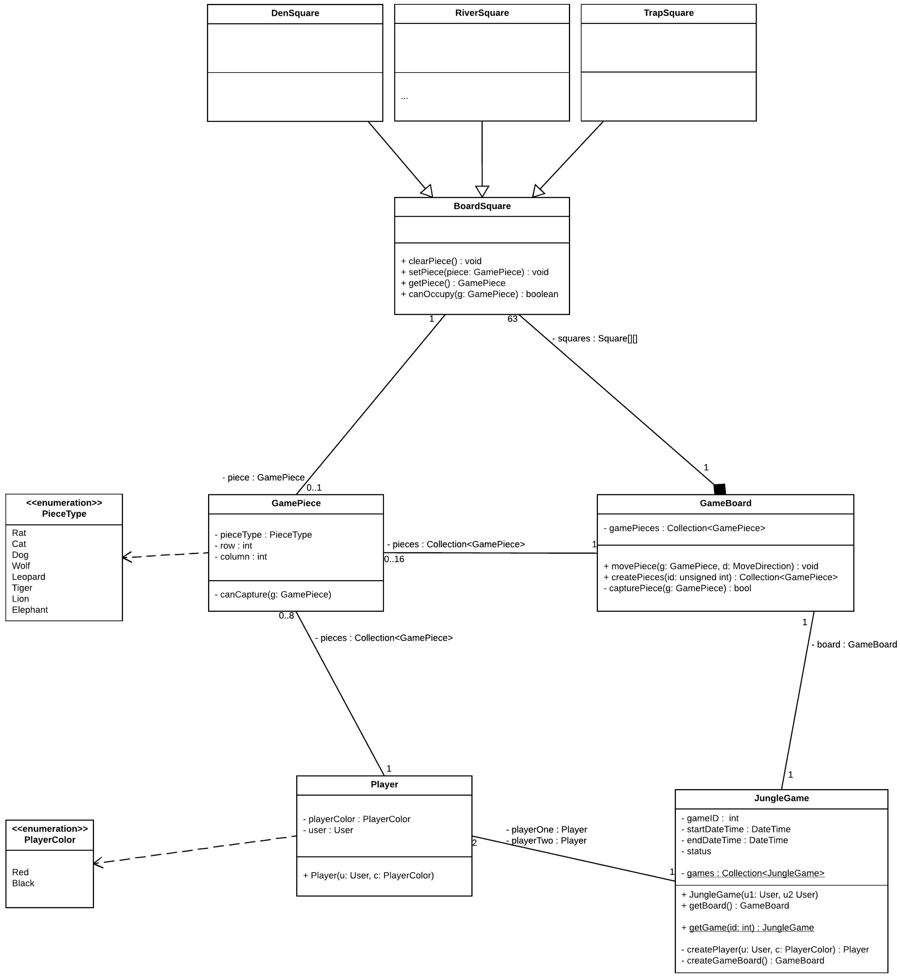
Design Class Diagram: Jungle Game

Slide 6
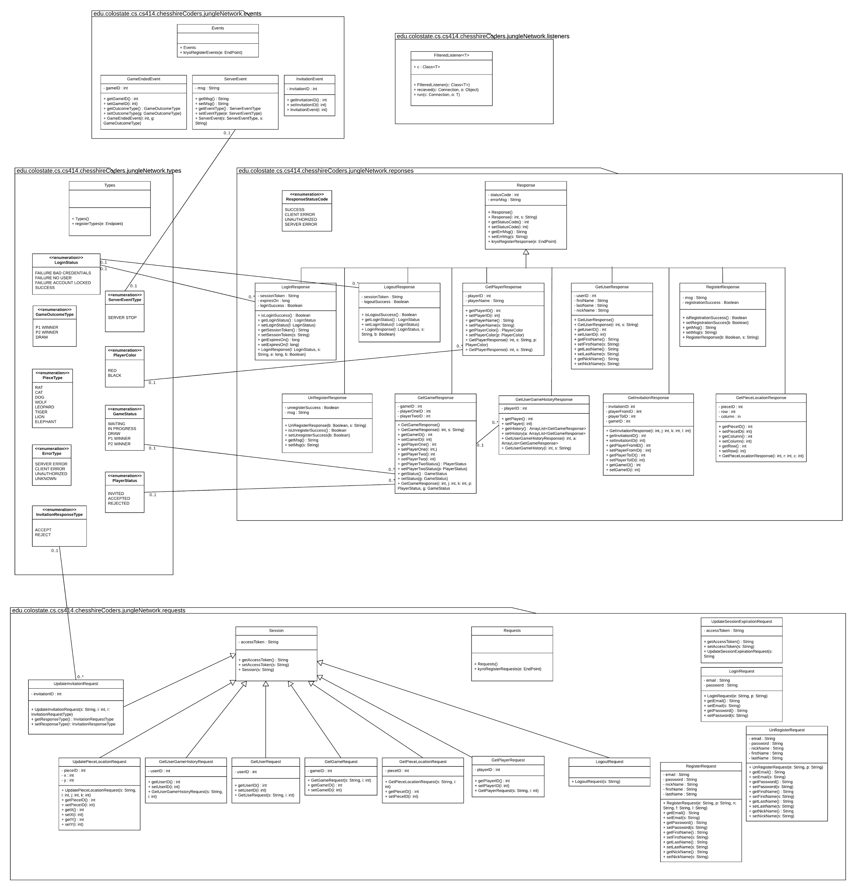
Design Class Diagram: Jungle Network

Slide 7
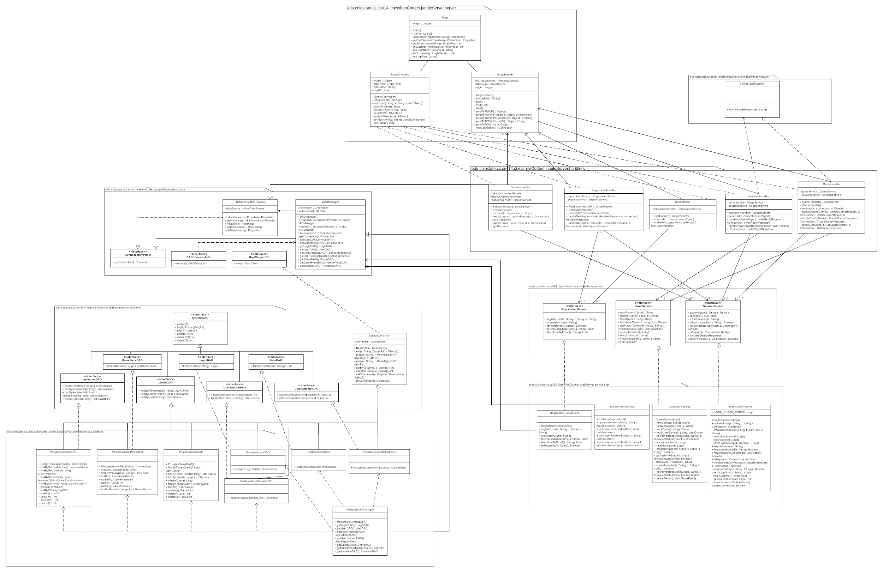
Design Class Diagram: Jungle Server

Slide 8
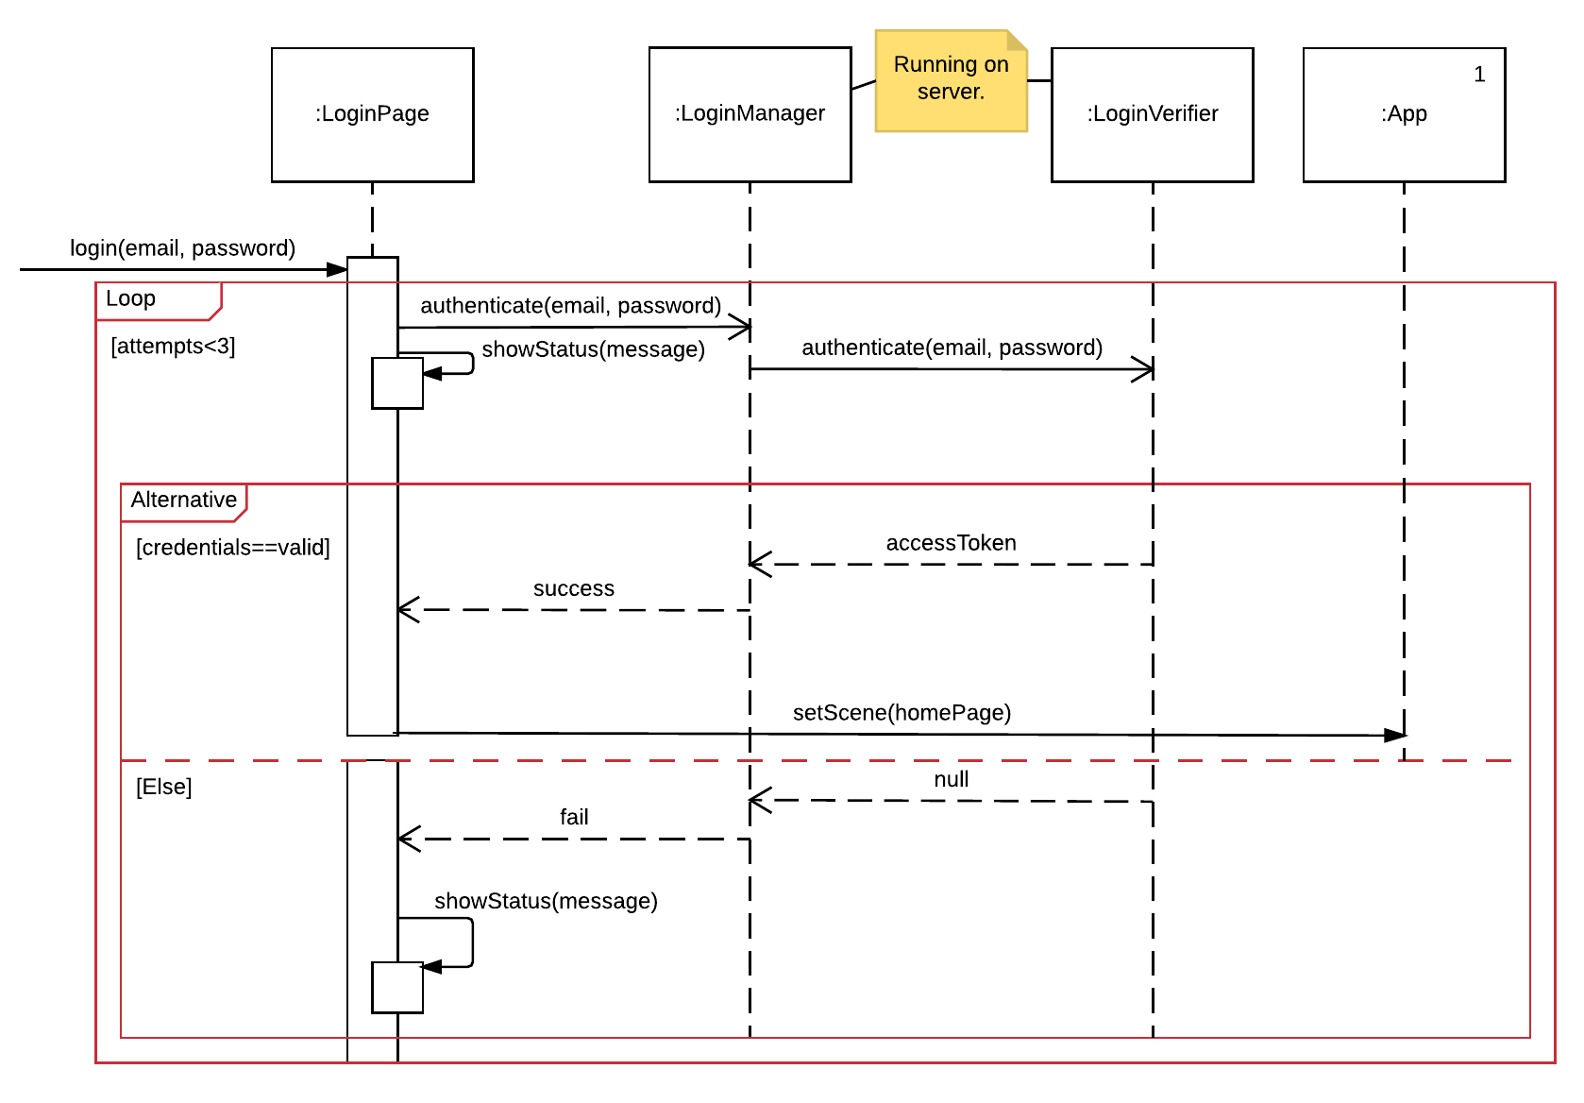
Sequence Diagram:
Login

Slide 9
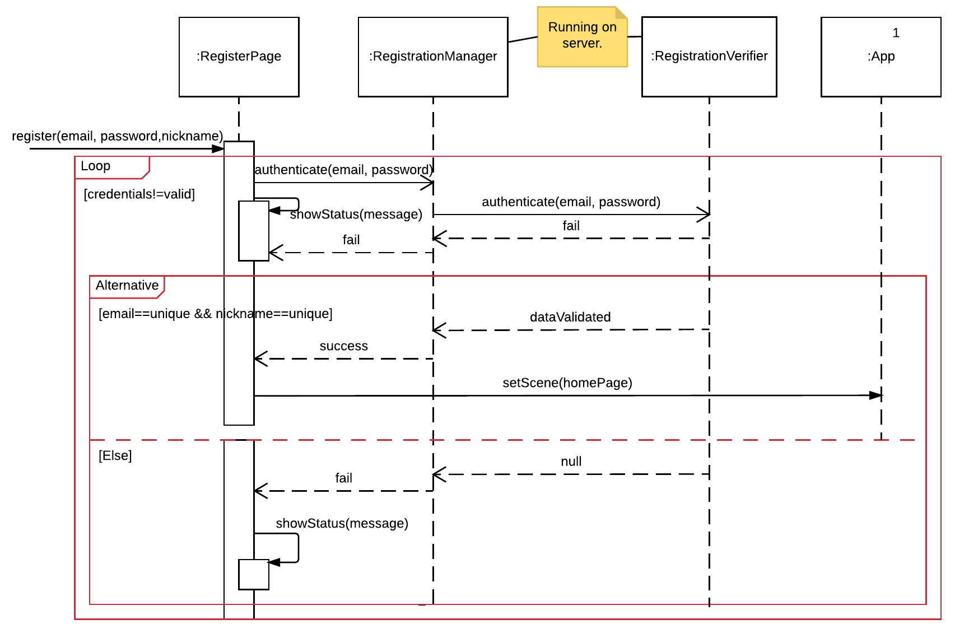
Sequence Diagram:
Register

Slide 10
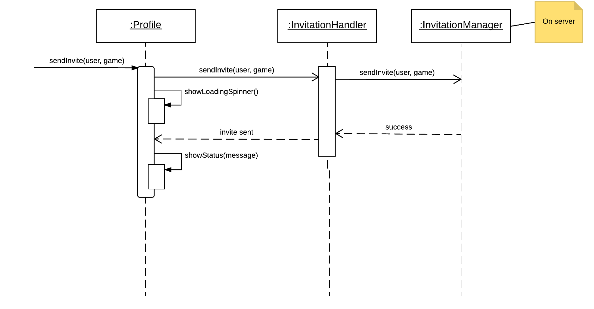
Sequence Diagram:
Game Invite

Slide 11
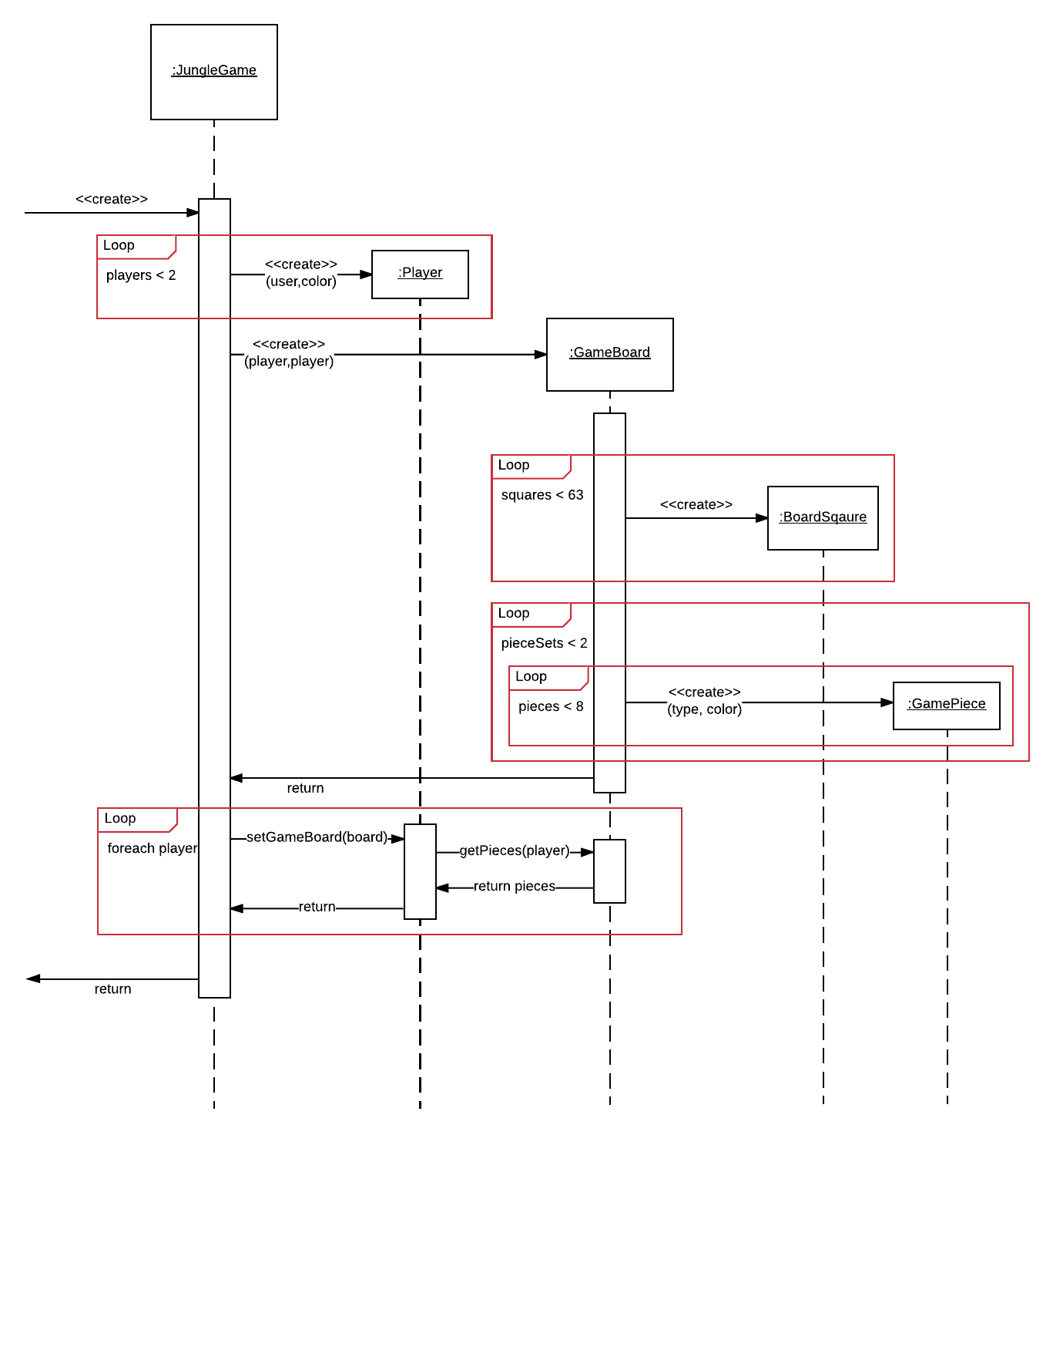
Sequence Diagram:
Create Game

Slide 12
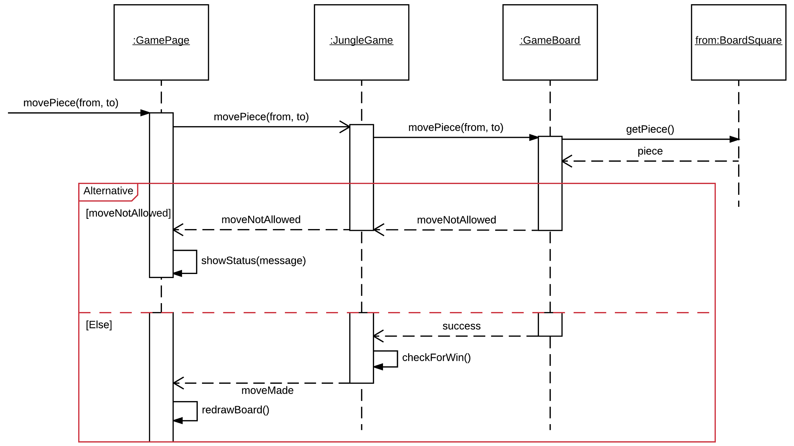
Sequence Diagram:
Take Turn

Slide 13
Refactoring and Design Pattern List
Singleton
Factory Method
Abstract Factory Method
Prototype
Facade
Decorator

Slide 14
Traceability Link Matrix
 | Login | Jungle Game | Game Board | Game Piece | Board Square | Player | User | Invite Manager | Invitation
#1: Register to the system | x |  |  |  |  |  | x |  | x
#2: Create a new game | x | x | x |  |  |  |  |  | x
#3: Invite other users to a game | x |  |  |  |  |  |  | x | x
#4: Respond to Game Invitation | x |  | x |  |  | x |  | x | x
#5: Quit Game | x | x | x |  |  | x
#6: Unregister from System | x |  |  |  |  |  | x
#7: View Player Profile | x |  |  |  |  | x
#8: Log in to System | x |  |  |  |  |  | x
#9: Log out of System | x |  |  |  |  |  | x
#10: Move Game Piece | x | x | x | x | x | x
#11: Switch Game | x | x | x |  |  | x

Slide 15
Demo

Slide 16
Questions
And
Discussion

